Slide 1




Sepsis Atlas Hackathon 2026
Team 1

Slide 2
TABLE OF CONTENTS
01
02
03
04
05
GOAL
ARCHITECTURE
OUTPUT
IMPROVEMENTS
CONCLUSION

Slide 3

01
GOAL

Slide 4
Problem Statement
Manual meta-analysis slow and non-scalable
Medical evidence inside thousands of PDFs
Doctors need structured, analysis-ready evidence
Goal: Convert papers into searchable evidence.

Slide 5
Project Goal
Read medical papers
↓
Extract relevant findings
↓
Structure evidence
↓
Produce easy-to-read output

Slide 6

02
ARCHITECTURE

Slide 7

0 1 2 3
0
1
0
3
4
5
6
0
1
+
3
4
5
6
Medical files for data

Slide 8
0 1 2 3
0
1
2
3
4
5
3
Variables considered

Slide 9
0 1 2 3
0
1
2
3
4
5
6
Output table

Slide 10
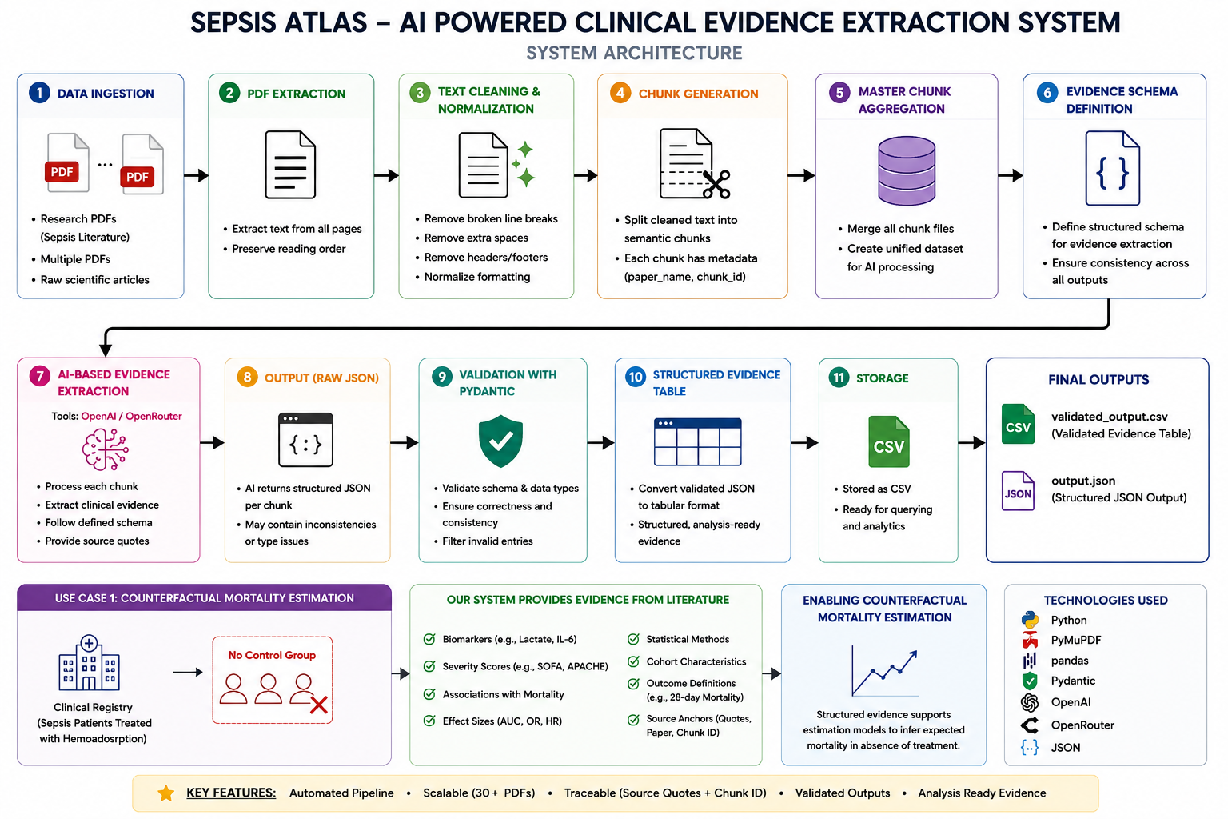

Slide 11
PDF Extraction
Objective
• Convert raw medical research PDFs into machine-readable text
What I Built
• Automated PDF ingestion pipeline
• Extracted text using PyMuPDF
• Processed multiple sepsis research papers automatically
Why It Matters
• Research PDFs are unstructured and difficult for AI systems to process directly
• This converts:
Research PDFs → Raw Text

Slide 12
Text Cleaning & Normalization
Problem:
• Raw PDF text contains:
- broken lines
- spacing issues
- formatting noise
What I Built:
• Automated cleaning pipeline
• Removed broken line breaks and duplicate spaces
• Normalized text into AI-readable format
Why It Matters: LLMs perform better on clean and continuous text

Slide 13
Chunk Generation Pipeline
Problem:
• LLMs cannot efficiently process very large medical papers at once
What I Built:
• Split cleaned papers into AI-processable chunks
• Created structured chunk format with: paper name, chunk ID, text
Why It Matters:
• Enables scalable AI processing
• Enables source traceability

Slide 14
Multi-PDF Automation System
Initial Prototype: Pipeline first tested on a single PDF
What I Improved:
• Scaled into fully automated multi-document processing
• Automatically extracts, cleans, chunks, and saves outputs
Why It Matters: Transformed the project from
manual workflow → scalable AI infrastructure
Result: Processed 30+ medical research papers automatically

Slide 15
LLM Layer
Clean chunks
↓
Extract relevant information
↓
Consider output schema
↓
Return schema-fulfilling JSON output

Slide 16
VALIDATION INFRASTRUCTURE
Objective: Prepare AI-ready structured medical evidence
What I Built:
• Designed evidence schema and validation pipeline
• Used: Pydantic, pandas, JSON
Final Outputs:
• all_chunks.json
• evidence_schema.json
• final_evidence_table.csv

Slide 17

03
OUTPUT

Slide 18
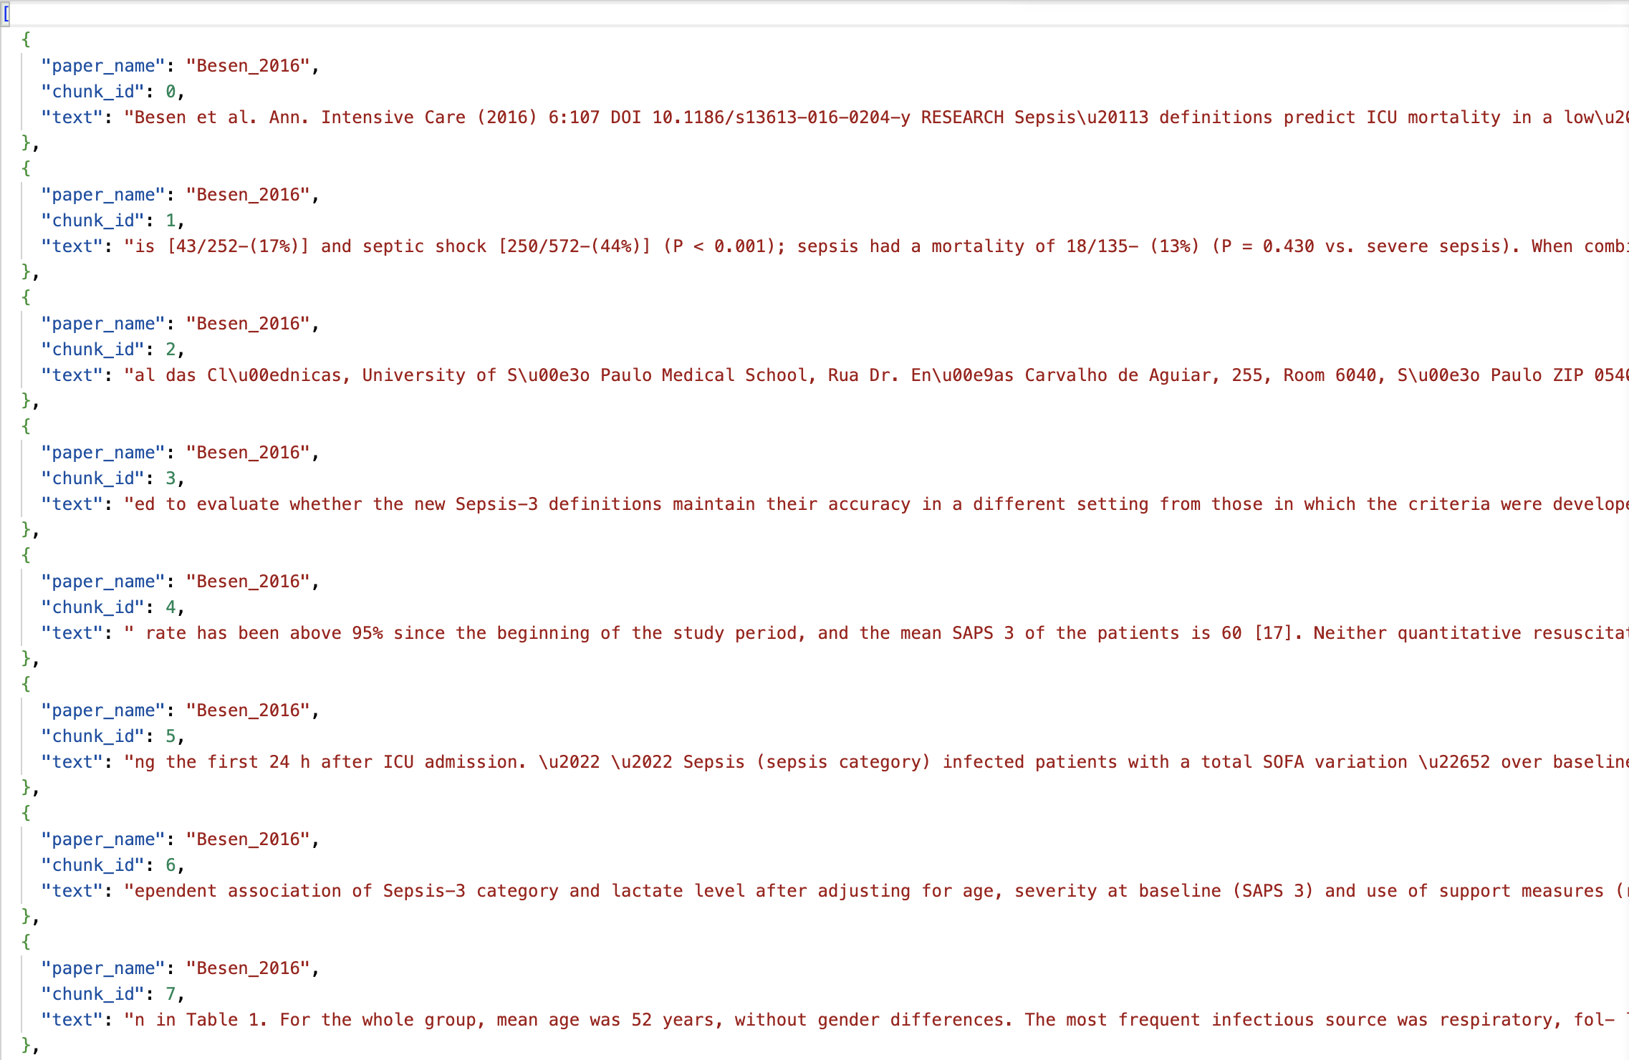
chunks.json

Slide 19
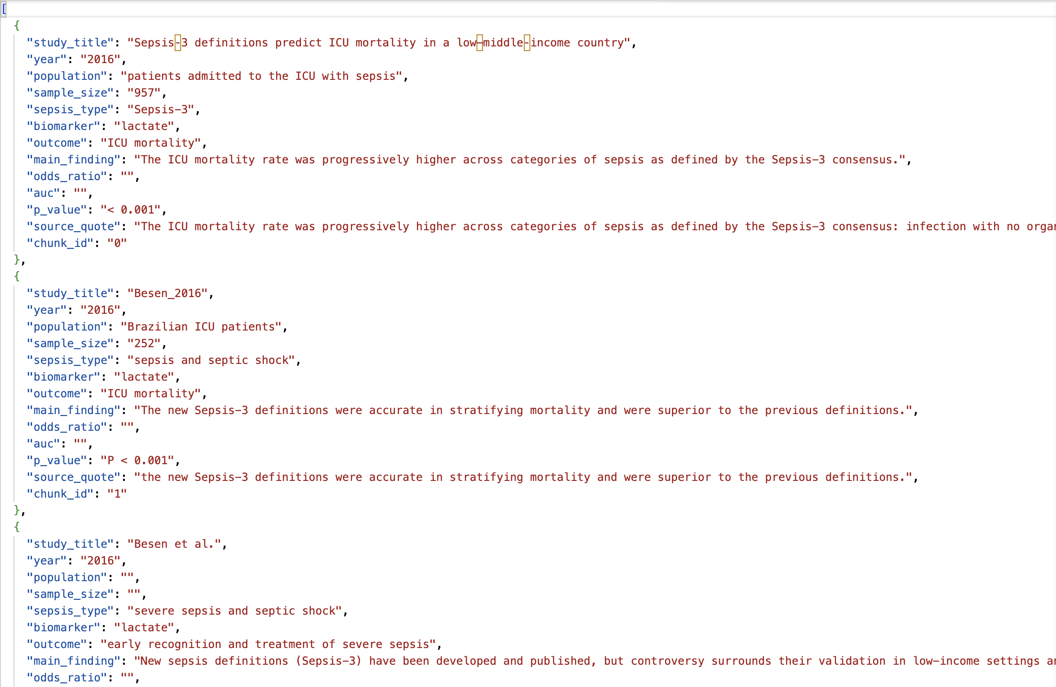
output.json

Slide 20
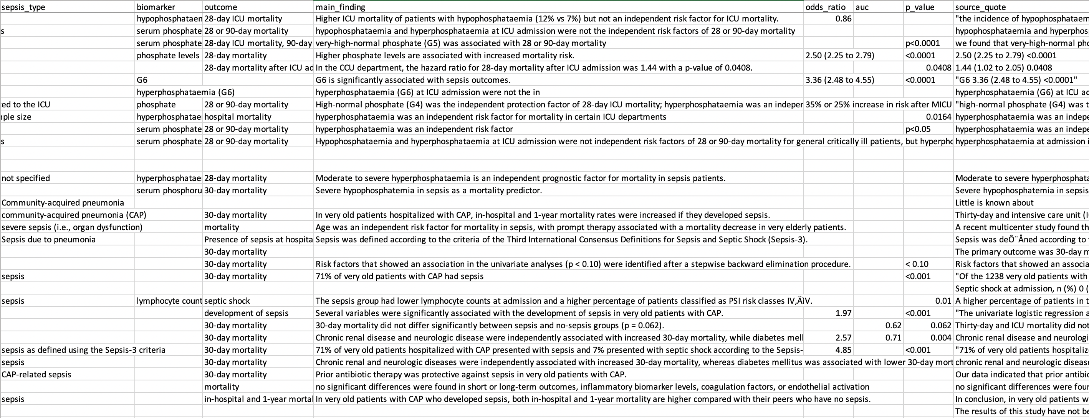
validated_output.csv

Slide 21

04
FUTURE IMPROVEMENTS

Slide 22
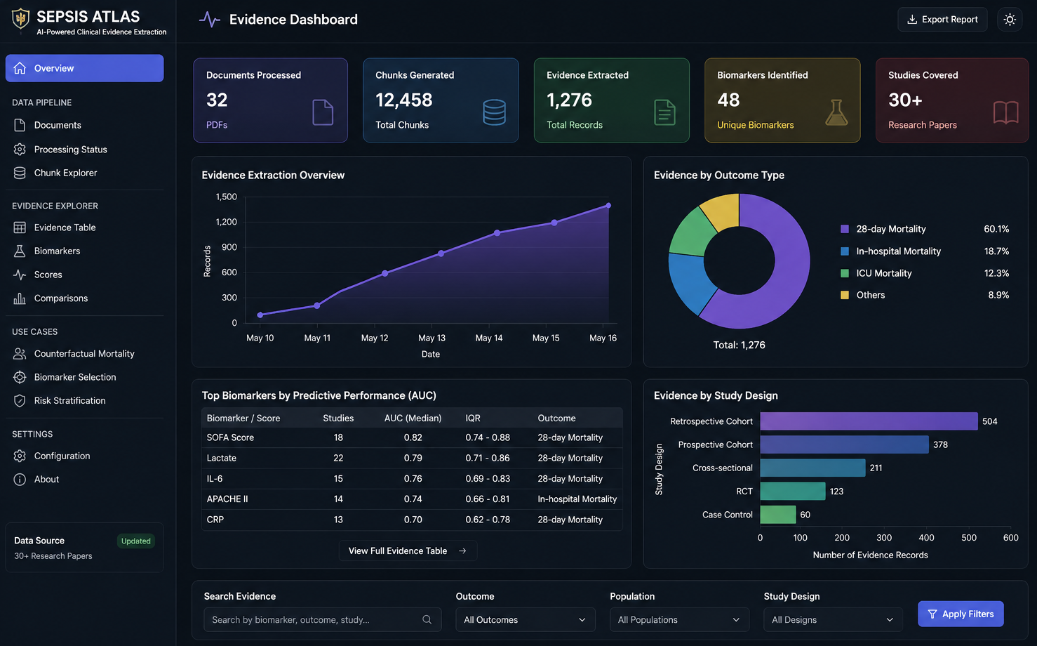
• Streamlit dashboard • Semantic search • SQL backend • RAG integration • Advanced medical querying

Slide 23
05
CONCLUSION

Slide 24
Sepsis Atlas transforms unstructured medical literature into structured, scalable, analysis-ready clinical evidence.

Slide 25
THANKS!
Team 1

